Slide 1
Secure Data hiding in image using steganography
CAPSTONE PROJECT
Presented By: Vaishali Trama
Student Name : Vaishali Trama
College Name : Kasturba DSEU Pitampura Campus
Department : BCA

Slide 2
OUTLINE
Problem Statement
Technology used
Wow factor
End users
Result
Conclusion
Git-hub Link
Future scope

Slide 3

Problem Statement
With increasing concerns about data security and privacy, there is a need for secure methods to hide sensitive information within digital media. This project addresses the challenge of hiding secret messages inside images using steganography, ensuring confidentiality and protection against unauthorized access.
Concealed Information
Embedded secret message within an image by modifying pixel values without noticeable distortion.
Security
Protecting hidden information using a passcode-based authentication system.
But what will we get from this?
Retrieved Hidden Data
Extracting and reconstructing the hidden message only when the correct passcode is provided.

Slide 4
Technology used
Python
Programming language used for implementing the steganography algorithm
Operating System
Windows
OpenCV (cv2):
Used for reading and writing images, manipulating pixel values for encoding and decoding the secret message
String Encoding
Uses ASCII values to convert characters into pixel values and vice versa for hiding and retrieving messages.
OS Module
For handling file operations, such as opening the encrypted image

Slide 5





Wow factors
Simple Pixel Modification for Encoding
Passcode-Based Security
Efficient Pixel Distribution Strategy
Minimal External Dependencies
Automatic Image Opening Post-Encryption

Slide 6

End users
Cybersecurity Enthusiasts & Researchers
Digital Forensics Experts
Military & Intelligence Agencies
Privacy-Conscious Individuals
Journalists
Developers & Engineers

Slide 7

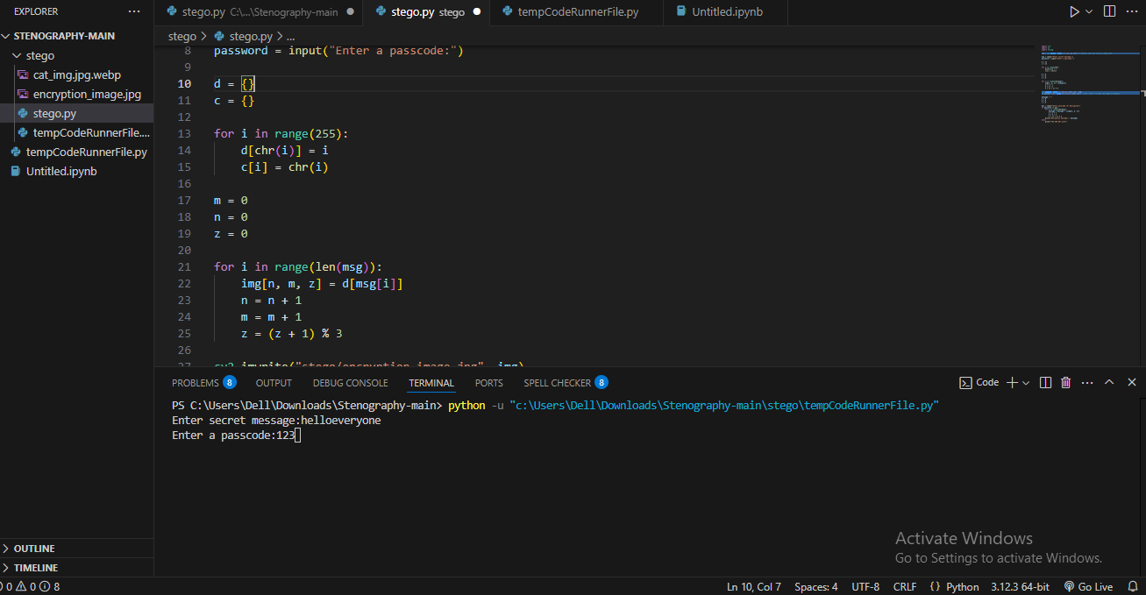
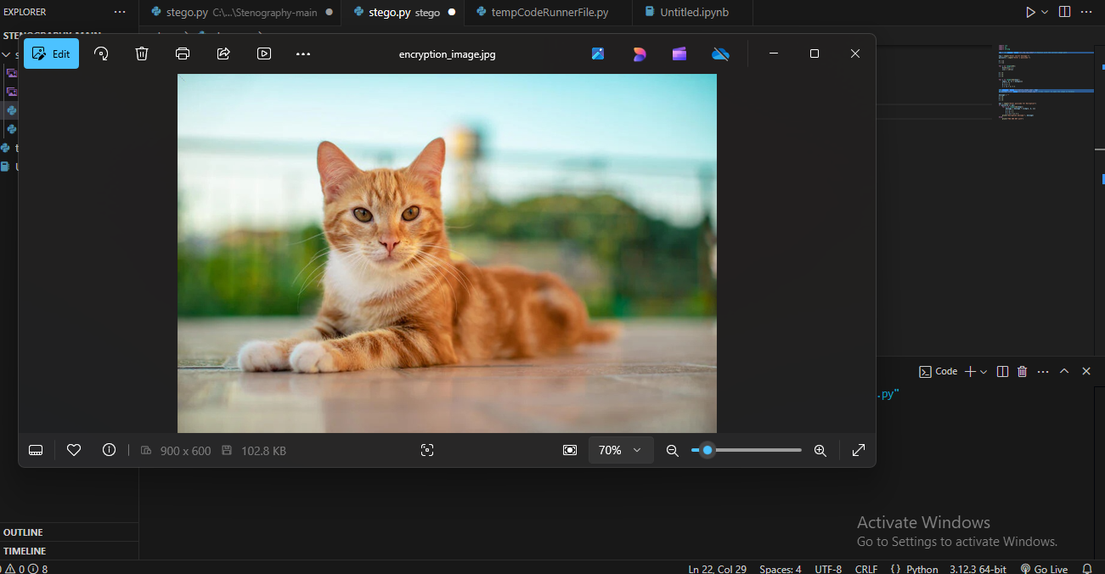
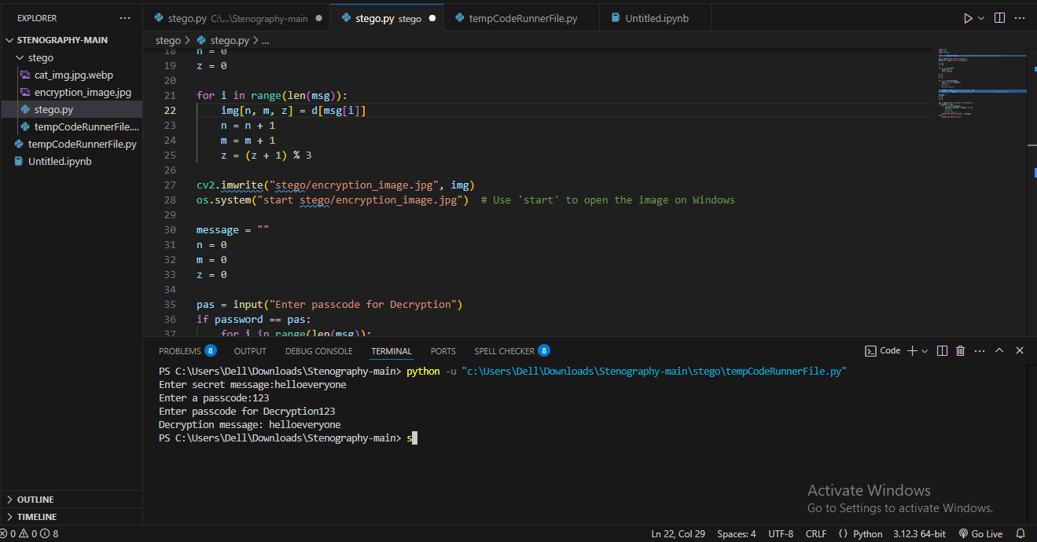
Results
Code, secure message and password, encrypted image and retrieved decryped message in the below 4 screenshots
1. 2.
3. 4.

Slide 8
Conclusion
The project successfully embeds and retrieves hidden messages within digital images while maintaining confidentiality.
Pixel values are modified to hide sensitive information without noticeable changes.
A passcode-based authentication system ensures only authorized users can decrypt the message.
The hidden message can be successfully extracted and recovered with the correct passcode.
Future improvements can include stronger encryption, multi-layered security, and robustness against image compression.
The project demonstrates the importance of steganography in secure communication and data protection.

Slide 9
GitHub Link
vaishaliTrama (vaishaliTrama) / Repositories · GitHub

Slide 10
Future scope(optional)
Increased Capacity
Optimizing data embedding to store larger messages without noticeable distortion.
Resistant to Detection
Implementing noise reduction and adaptive hiding techniques to evade steganalysis.
Enhanced Security
Implementing stronger encryption algorithms (AES, RSA) before embedding data
Cross-Platform Compatibility
Expanding functionality for mobile and web applications
Improved Encoding Efficiency
Using advanced steganographic techniques like LSB (Least Significant Bit) modifications
Multi-layer Protection
Adding multiple passcodes or biometric authentication for decryption

Slide 11
THANK YOU

